Slide 1
MATLAB based research for diff: type’s digital modulation on BER & AWGN channels
by
Hafiz Muhammad Attaullah
Github Repo.
https://github.com/attaullahshafiq10/digi-com
Faculty of Engineering & Technology,
University of Sindh, Jamshoro
Notes:
Video link:

Slide 2
Contents
Abstract
Introduction
Motivation and Need
Aims and Objectives
Tools and Technologies
AWGN Channel & BER
Digital Modulation
Simulink Model
Development Methodology
Final Results
Table
Conclusion
References.

Slide 3
Abstract
In this report we introduce three basic types of digital modulation techniques, followed by an evaluation of the receiver's bit rate performance characteristics using the MATLAB Simulink Model for FSK, PSK and QAM modulation techniques.
In this report, the AWGN channel is used between transmitter and receiver. We focuses on the characterization and the design of analog signal waveforms that carry digital information and compares their performance on an AWGN channel.

Slide 4
Motivation and Need
In the recent times for fast growing wireless technologies, the performance of the transmitting and receiving systems is very important.
Digital modulation schemes contribute to the evolution of mobile communications by increasing the capacity, speed as well as the quality of the wireless network. Digital modulation schemes provide more information carrying capacity, better quality communication, data security and RF spectrum sharing to accommodate more services.
So we have to analyze the parameters, component, and structures of the channels.

Slide 5
Aims and Objectives
Design the analog signal waveforms that carry digital information and compares their performance on an AWGN channel.
Evaluated bit error rate performance, characteristics of receiver by using MATLAB Simulink model for FSK, PSK and QAM modulation techniques.

Slide 6
Tools and Technologies
MATLAB
Simulink
Symbolic Math Toolbox
Modulation Techniques

Slide 7
AWGN Channel
AWGN channel is a channel's simplest model, and is well suited for wired communication. This channel is (LTI) linear and time-invariant.
As signal passes through it, AWGN channel adds white Gaussian noise to the signal. The amplitude frequency response of this channel is flat, and phase response for all frequencies is linear. It moves through the modulated signals without any loss of amplitude or phase distortion. So, in such a case, there is no fading but the AWGN introduces the only distortion that exists. The signal (received) is simplified to:
𝑟(𝑡)=𝑥(𝑡)+𝑛(𝑡)
Where n(t) represents the noise, Gaussian distribution has the mean and variance of 0 as the transmitted signal is defined by the noise power and x(t).
Notes:
Additive white Gaussian noise is a basic noise model used in information theory to mimic the effect of many random processes that occur in nature. The modifiers denote specific characteristics: Additive because it is added to any noise that might be intrinsic to the information system.

Slide 8
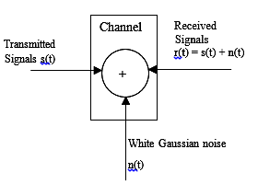
AWGN Channel
Notes:
Typical quantities used to describe the relative power of noise in an AWGN channel include;
Signal-to-noise ratio (SNR) per sample. SNR is the actual input parameter to the awgn function.
Ratio of bit energy to noise power spectral density (EbN0). This quantity is used by BER Analyzer Tool and performance evaluation functions in this toolbox.
Ratio of symbol energy to noise power spectral density (EsN0)

Slide 9
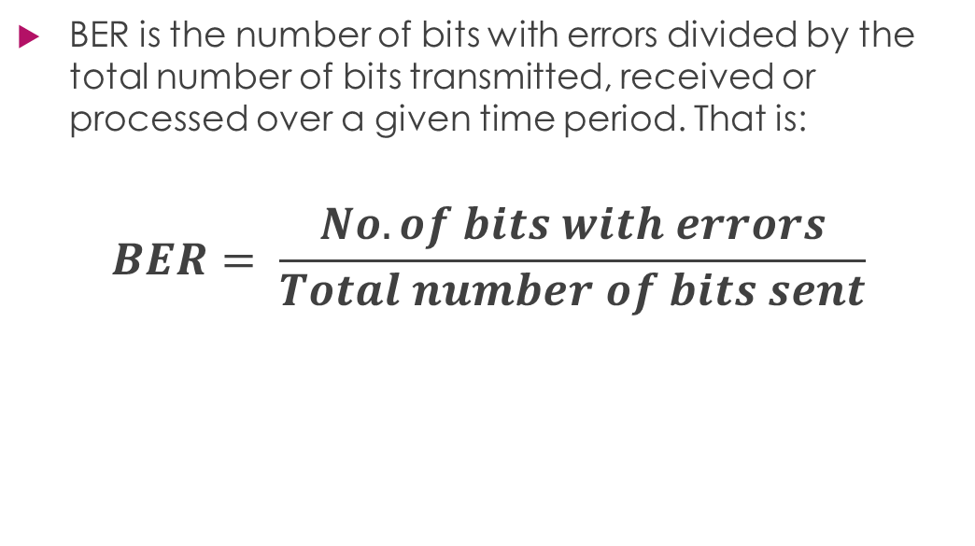
Bit Error Rate(BER)
BER is the number of bits with errors divided by the total number of bits transmitted, received or processed over a given time period. That is:
$$BER= \frac{No. of bits with errors}{Total number of bits sent}$$
Notes:
Bit error rate is a key parameter used to assess the performance of the systems which transmits digital data from one location to another. There is a probability that errors can be introduced into the network as data is transmitted over a data link. As a result, the performance of the system needs to be assessed, and BER provides an ideal way to achieve that.

Slide 10
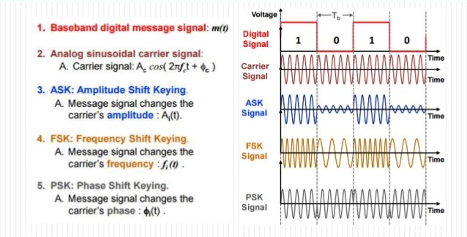
Digital Modulation
Notes:
Digital Modulation and is a generic name for modulation techniques that uses discrete signals to modulate a carrier wave.
Easy and simple type of digital modulation is Amplitude Shift Keying (ASK). The digital input is NRZ unipolar. Amplitude in ASK carrier is multiplied by high amplitude for binary "1," or low amplitude for binary "0.“
In frequency shift keying (FSK), the carrier frequency is shifted between two discrete values, one representing binary "1" and representing binary "0," but the amplitude of the carrier does not change. FSK in its simple form is BFSK.
In phase shift keying (PSK), the carrier phase is modulated in order to represent the binary values. The carrier phase shifts via the optical bipolar signal between 0 and ÿ. The Binary states "1" and "0" are represented by the digital signal's positive and negative polarity

Slide 11
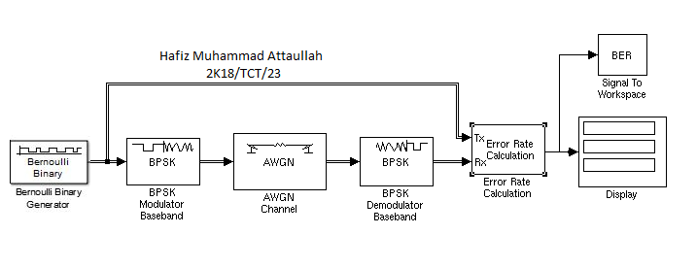
Simulink Model
Simulink Model for BPSK
Notes:
Binary Phase Shift Keying (BPSK) is a two phase modulation scheme, where the 0's and 1's in a binary message are represented by two different phase states in the carrier signal: for binary 1 and. for binary 0.

Slide 12
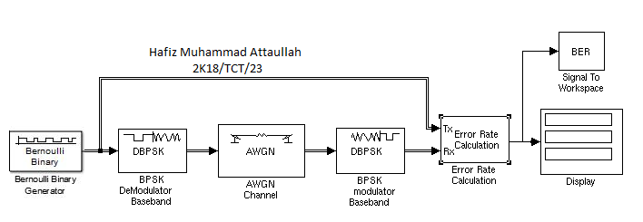
Simulink Model
Simulink Model for DBPSK

Slide 13
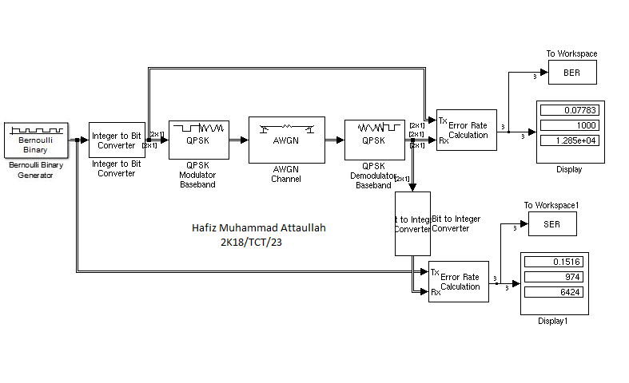
Simulink Model
QPSK Modulation and Demodulation Simulink Model

Slide 14
Design and Development Methodology
MATLAB simulation model consists of transmitter, channel and receiver. The AWGN channel is used between transmitter and receiver. At the transmitter end data is generated by Bernoulli data generator. Bernoulli data generator generates data with probability a zero 0.5 and sample time one second. The bit error rate (BER) of different types of digital modulation can be calculated through Monte Carlo simulations using MATLAB Simulink file.

Slide 15
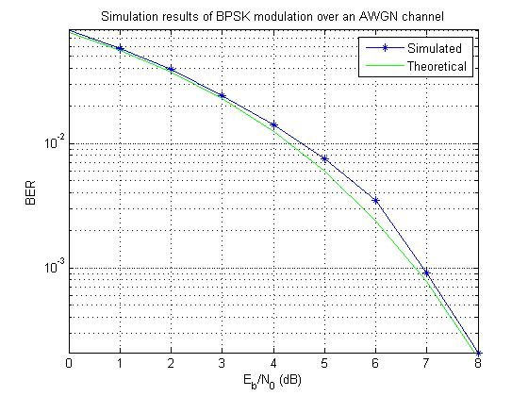
Final Results

Slide 16
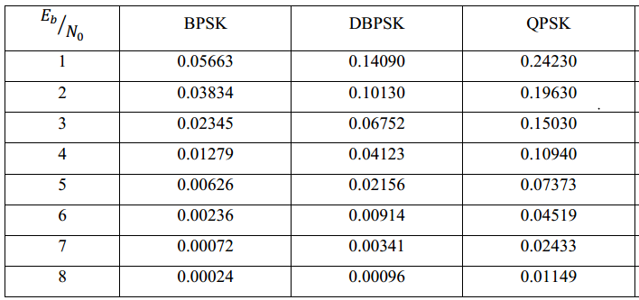
Table
Bit Error Rate for 100000 bits transmission.

Slide 17
Conclusion
In this report; three basic types of modulation was discussed. A number of modulation schemes such as BPSK, QPSK, DBPSK, and QAM have been consider for MATLAB simulation purposes.
Their BER have been evaluated using MATLAB Monte Carlo simulation tool for additive white Gaussian noise channel and also some MATLAB coding. We have concluded from the above figures depending on bit error rate that BPSK is the most effective modulation schemes in a practical communication system.

Slide 18
References
[1] Tang, Y. and Lv, X.L., 2011, September. Research on the modulation and demodulation of BPSK and BDPSK simulator based on Matlab. In 2011 International Conference on Electrical and Control Engineering (pp. 1239-1241). IEEE.
[2] Ndujiuba, C.U., Oni, O. and Ibhaze, A.E., 2015. Comparative analysis of digital modulation techniques in LTE 4G systems. Journal of Wireless Networking and Communications, 5(2), pp.60-66.
[3] Sadeque, G., 2015. Bit Error Rate (BER) Comparison of AWGN Channels for Different Type’s Digital Modulation Using MATLAB Simulink. American Scientific Research Journal for Engineering, Technology, and Sciences (ASRJETS), 13(1), pp.61-71
[4] Manhas, P. and Soni, M.K., 2015. BER analysis of BPSK, QPSK & QAM based OFDM system using simulink. International Journal of Electrical and Electronics Engineers, 7(02).
[5] Sadinov, S.M., 2017, May. Simulation study of M-ARY QAM modulation techniques using Matlab/Simulink. In 2017 40th International Convention on Information and Communication Technology, Electronics and Microelectronics (MIPRO) (pp. 547-554). IEEE.
[6] Sulankivi, K., 2004. Benefits of centralized digital information management in multipartner projects. Journal of Information Technology in Construction (ITcon), 9(3), pp.35-63.
[7] Madon, S., Reinhard, N., Roode, D. and Walsham, G., 2009. Digital inclusion projects in developing countries: Processes of institutionalization. Information technology for development, 15(2), pp.95-107.

Slide 19
Thank You

